Slide 1
Vinchin Backup & Recovery
V9.0.0
Web Interface Updates

Slide 2
CONTENTS
PART 01
Navigation bar, Home page and Data Visualization
PART 02
Monitor Center Web
PART 03
Data Resilience Web
PART 04
Resources Web
PART 05
System and License Web

Slide 3
PART 01
Navigation bar, Home page and Data Visualization

Slide 4
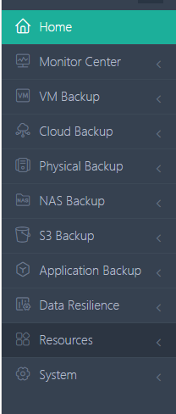
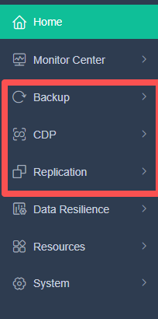
Menu/Navigation Bar
What changes have we made?
Menu consolidation – Significantly reduced number of menu items.
Module categorization – Business modules now grouped into three main categories:
Backup / Replication / Real‑Time Protection
Unified data view – All module‑specific [Backup Data] sections are now merged into a single [Data Management] entry.
V8.1
V9.0
Purpose and Effects:
Improved navigation experience – Eliminates excessive menu expansion and scrolling as more modules are added.
Clearer product capability mapping – Reflects the three core data protection pillars:
Scheduled Backup / CDP / Replication.

Slide 5
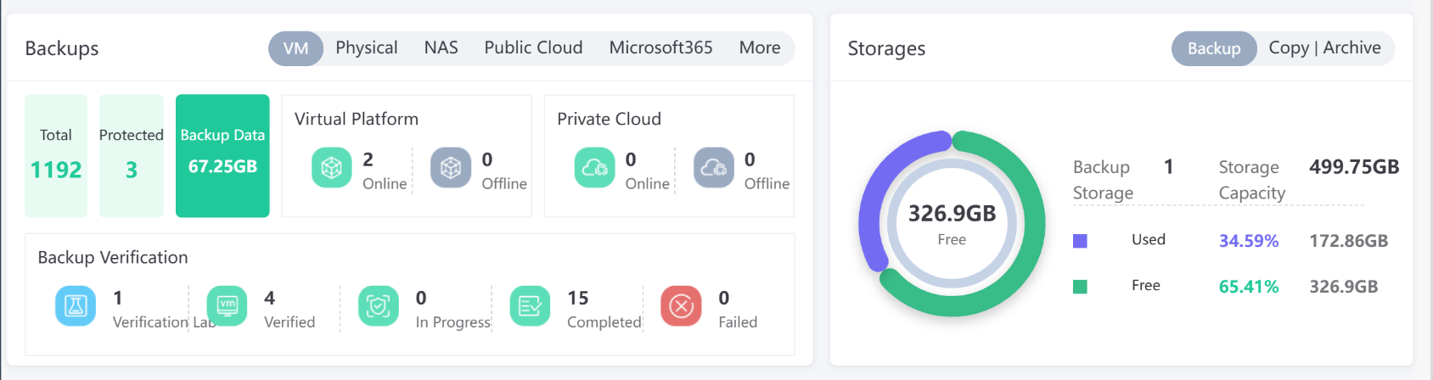
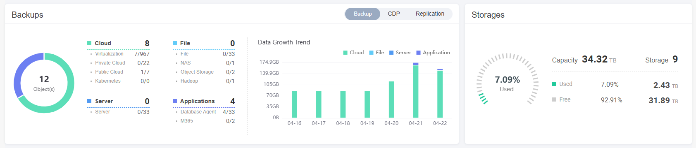
Homepage
V8.1
V9.0
What changes have we made?
Data protection objects are divided into three main categories: Scheduled Backup / CDP / Replication.
Each category of data objects is simplified and displayed as a list consisting of a name and a number.
Purpose and Effects:
Object categorization aligns with the navigation bar
The display of detailed information is cleaner and clearer

Slide 6
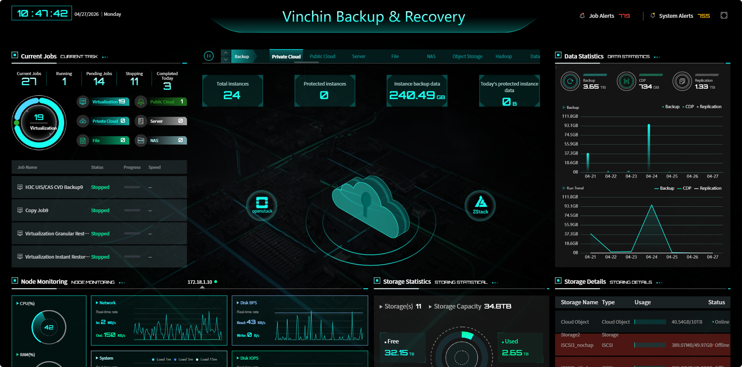
Data Visulazition
Adjustments & Effects:
UI layout tightened toward center to reduce empty space.
Data categories now align with the navigation bar.
Added backup data volume trend statistics.

Slide 7
PART 02
Monitor Center Web

Slide 8
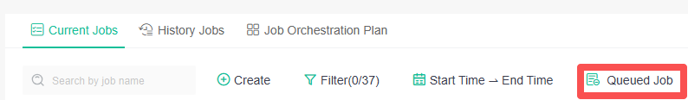
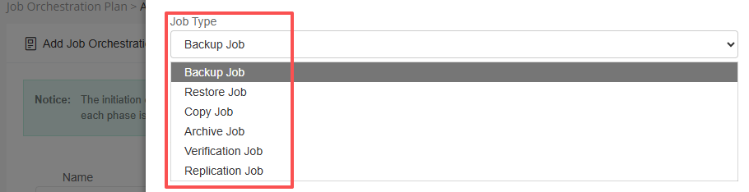
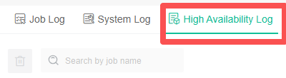
Monitor Center-Job
What have we optimized？
1、Added [Queued Jobs] – Shows jobs queued due to resource shortage: tape jobs (backup, copy, archive) when drives are busy, and verification jobs when system resources are insufficient. Other job types not included.
5、HA Logs – Records cluster node and resource switch events.
2、Job Orchestration – Added Replication job type support.
3、Job Details – Added a side drawer to display job configuration details, improving readability for jobs with numerous settings.
4、History Jobs – Now includes all the run logs of history jobs for easier troubleshooting.

Slide 9
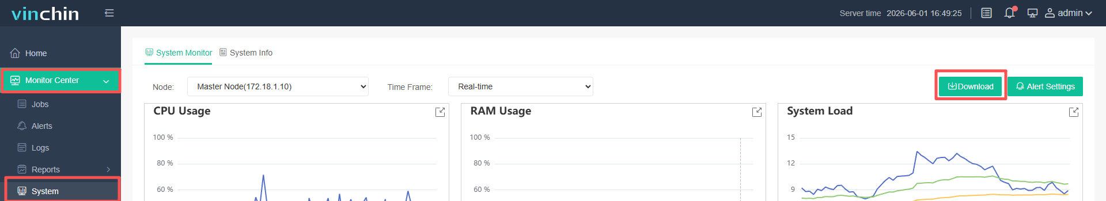
Monitor Center-System
What have we optimized？
1、 The [Download] System Logs button has been moved to the [Monitor Center] – [System] interface.

Slide 10
PART 03
Data Resilience Web

Slide 11
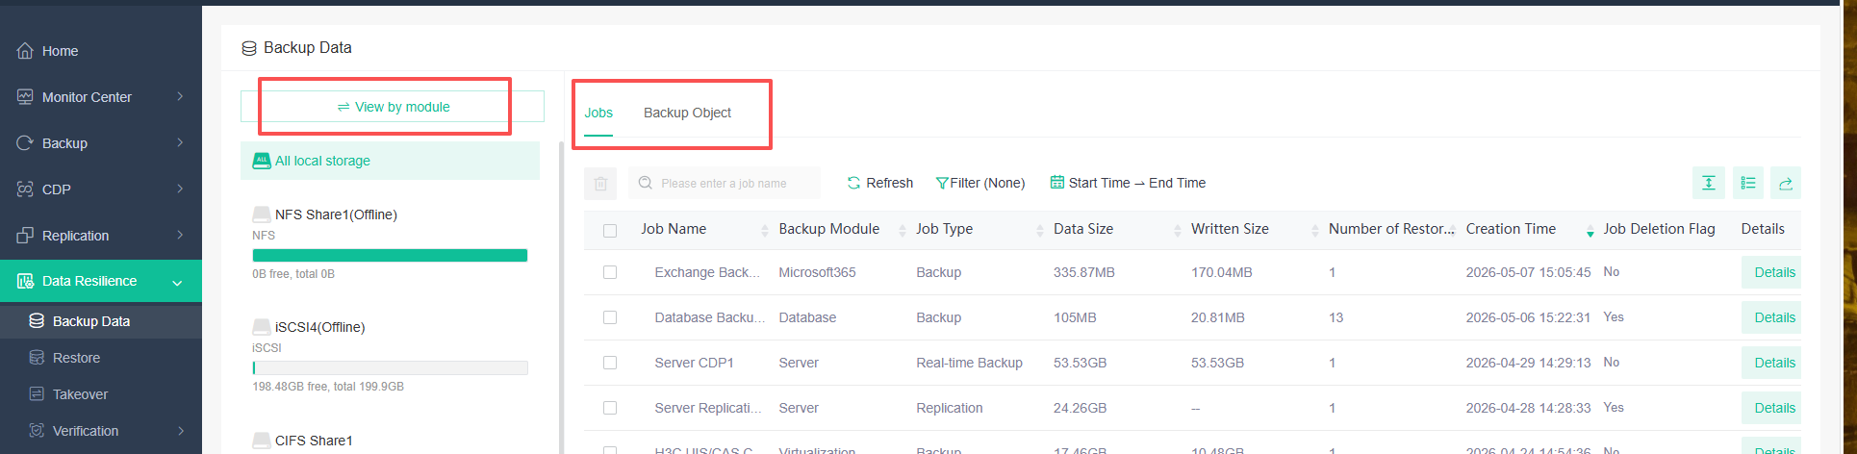
Data Resilience – Backup Data
What have we optimized？
Centralizes all backup data operations (view, restore, takeover, copy & archive, verification) into one entry point.
Notes:
1、按业务模块/存储查看
2、按备份对象（单个机器）、任务查看
3、详情，展示结构变化（树形-层级）依赖当前完备点的备份点数量，从备份数据这里进入各类恢复任务创建流程，单独对备份点设置WORM时间等。
4、备份数据状态，合并、扫描、删除、校验等，方便查看

Slide 12
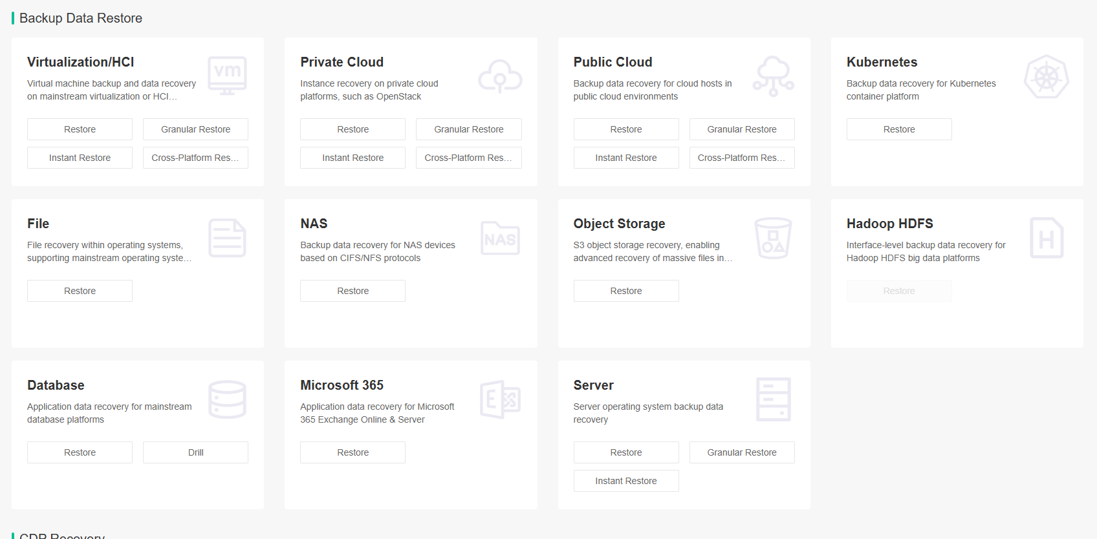
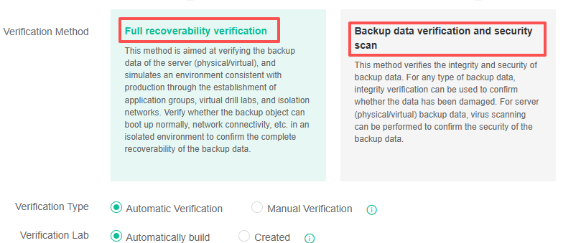
Data Resilience – Backup Data
What have we optimized？
Restore, takeover, verification, copy, and archive are now all presented from a backup object perspective.
Operation entries are centralized in one place, eliminating the difficulty of locating module-specific operations for first-time users.
Verification workflow reordered: Select verification method first, then select verification target (order reversed from previous version). Added Application Group for orchestrating verification of a group of related hosts. Added auto-build DR Lab.
Notes:
1、可以自动验证、手动验证
2、自动验证是验证最新时间点，可以设置时间策略，验证完成自动清理资源，用于批量对业务主机进行自动验证
3、手动验证可以指定时间点，任务一直运行，用户可以通过控制台再隔离环境中进入主机系统查看数据、验证等

Slide 13
PART 04
Resources Web

Slide 14
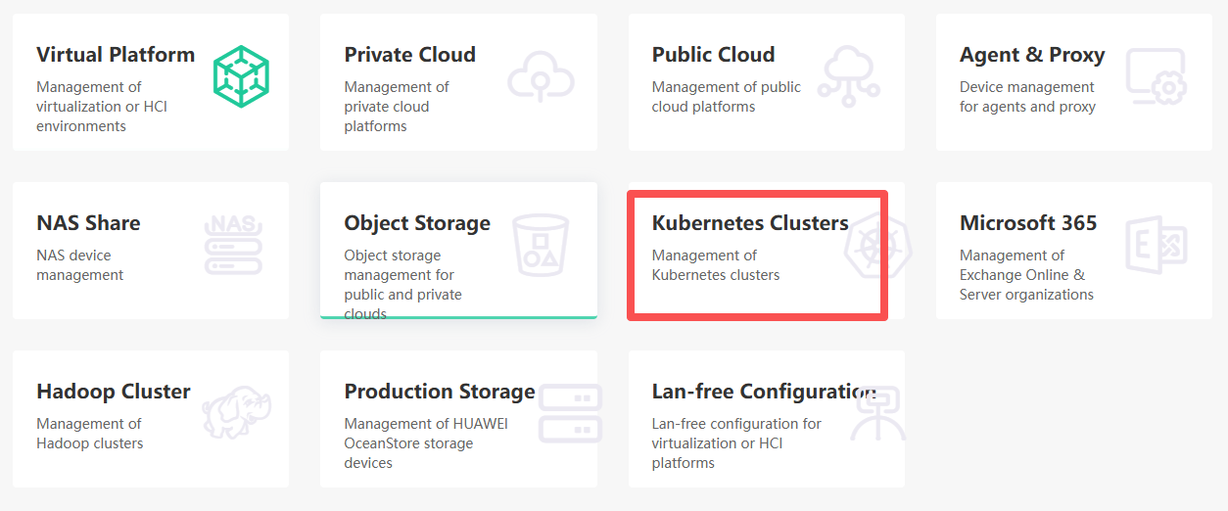
Resources-Infrastructure
All infrastructure items consolidated and displayed by backup object.
Added Kubernetes Cluster Management for new business modules.
Agent & Proxy – Added Proxy Pool for backup cluster scheduling and improved job success rates.
Added Bootable Image Download (LiveCD, WinPE).

Slide 15
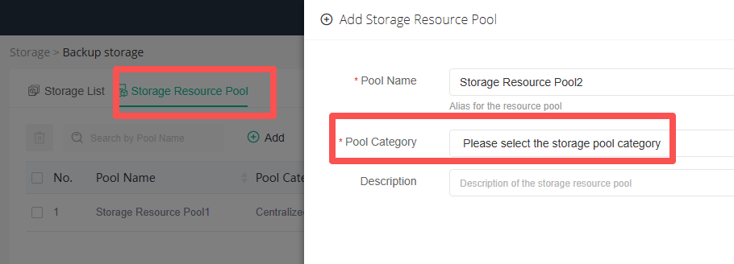
Resources-Storage
What have we optimized？
Added Storage Resource Pool to resolve the issue where a job would fail if its bound storage went offline — despite having multiple storages available in prior versions.
Note: Only storage of the same type can form a storage pool.
Storage is no longer categorized by purpose (backup, copy, archive, etc.). All storage is now general-purpose, removing previous usage logic restrictions on backup/copy data.
Tape management pages consolidated into a single page with tab switching.
Notes:
1、集中存储池、NAS存储池，云存储池，异地备份系统和磁带是无法加入存储池的
2、

Slide 16
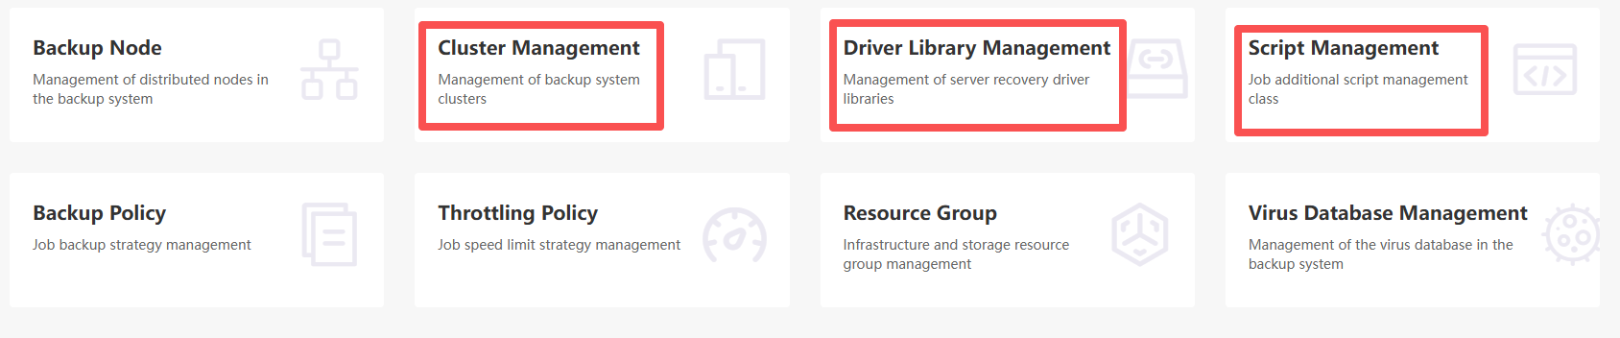
Backup Resource
What have we optimized？
Added Cluster Management, Driver Library Management, and Script Management.
Backup Node – Added Compute Resource Pool and Node Limitations.
Backup Node – Added Network Resource Pool (per individual node).
Notes:
1、集中存储池、NAS存储池，云存储池
2、异地备份系统和磁带是无法加入存储池的

Slide 17
PART 05
System and License Web

Slide 18
System Settings
[Storage Security] – [Storage Protection] renamed to [Ransomware Protection].
[System Security] – Added [API Security] ; enable to verify API signatures.
[Auditing Security] – Redesigned; supports on-demand retention policies and automatic cleanup of expired logs.
[Message Push] – Now supports both TCP and UDP syslog.
Added [API key Management] – Used for authentication when the centralized management platform connects to the backup system.
[User Management] – [Domain Server] – Added protocol selection (LDAP/LDAPS) when adding domain servers.

Slide 19
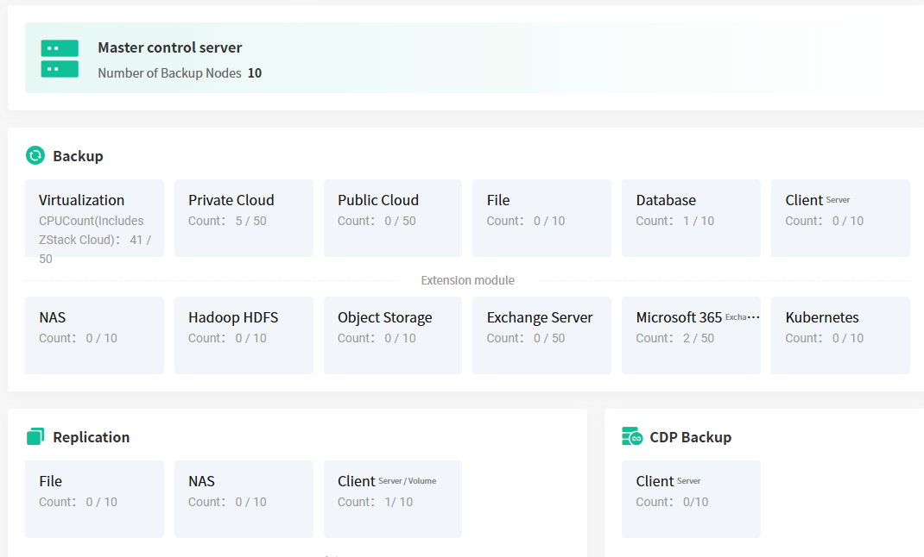
System License

Slide 20
THANKS

