Slide 1
Vinchin Backup & Recovery V9.0
Virtualization New Function

Slide 2
Contents
PART 01
VMware Expansion
PART 02
Backup Chain Merge Optimization
PART 03
Backup Function Expansion
PART 04
Recovery Function Expansion
PART 05
Data Verification
PART 06
Redesigning the Plugin Network/Process Structure

Slide 3
8.1-9.0 Optimization Summary
Permanent incremental backups cannot be enabled with compression, otherwise the data will grow larger and larger as it is merged—Modifications to the backup chain merge.
Performance Issues: Compared to competitors, backup and restore speeds are slow—features such as support for multiple virtual machines, multiple disks, and multi-threading for a single disk are currently only available on Huawei FC.
Regarding the narrowing gap between our virtualization module and those of our competitors—we will maintain and further expand our lead through new features such as automated verification, virus scanning, emergency takeover, X2X, and granular recovery options.

Slide 4
9.0 Added/Optimized Functions
Modules | Added/Optimized functions
VMware Backup | Source-side Compression
 | Asynchronous transmission
 | Scan Virtualization Optimization
Huawei FusionCompute- Parallel transmission | Parallel Transmission VMs | Parallel disk transfer for a single VM | Single Disk Parallel Transfer Thread
Data Merge | Permanent incremental data merge, Full + incremental/differential merge
Backup & Restore | Retry (network, operation, job)
 | Virus scanning
 | Integrity check
 | Overload protection
Backup | WORM
Restore | VM configuration optimization
Granular Recovery | Web download optimization | Client transmission | SMB network mount recovery
Instant Restore | Restore to DR Lab
X2X Cross-Platform Restore | V2V、V2C、V2P、C2C、C2V、C2P、P2V、P2C
 | Auto disk format conversion, config conversion, driver replacement, boot repair

Slide 5
New Compatibility & Features
Virtualization module – job Center: Modify backup policies without stopping jobs; changes take effect in next backup.
VM filter: Support multiple conditions for include/exclude.
Hyper‑V: Added instant restore to DR drill platform (migration back to original platform not supported yet).
Support for Lenovo AIO.
Support for Huawei Cloud Stack (HCS).
Virtualization Type | Architecture | Version | Storage
Huawei Cloud Stack（HCS） | x86 | 8.1.1 | OceanStor Pacific(FusionStorage)_8.1.2 OceanStor_V3

Slide 6
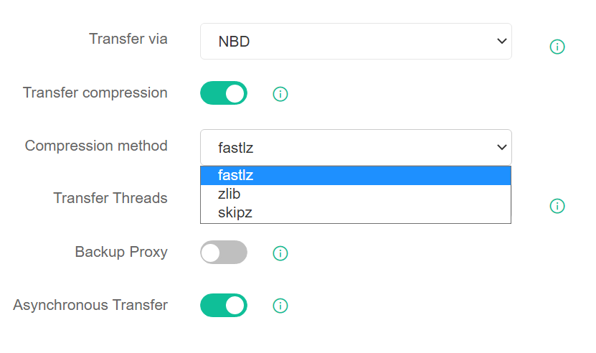
1.1 VMware Expansion
Source‑side Compression
Available for vSphere 6.5+, NBD/NBDSSL mode; compresses data at source to reduce network traffic and speed up backups.
Compression Method：
fastlz: Prioritizes speed, low memory, ~10% backup speed boost.
zlib: Prioritizes compression ratio; slightly slower but saves much bandwidth.
skipz: For regularly changing data; performance between fastlz and zlib; little benefit for random data and normal backup.
Asynchronous Transmission
Available for VMware 6.7+, NBD/NBDSSL mode; improves transfer speed. Disabled by default.

Slide 7
1.2 VMware Expansion
Virtualization Scan Optimization(adding virtualization centers) ： greatly reduces full scan time.
Test Environment: 1,300+ VMs | Time to Add VMware
V8.1 | 4 mins
V9.0 | 33 s
ps：Times vary by environment; for reference only.

Slide 8
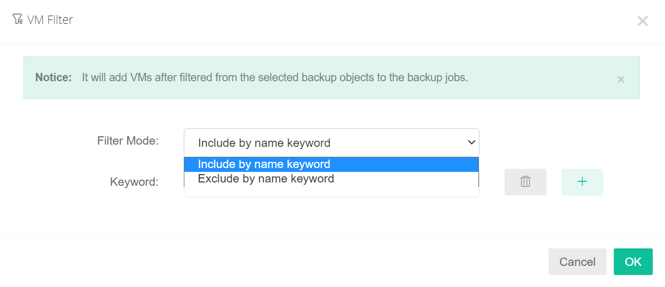
1.3 VM Filter
Match by name keyword
Exclude by name keyword
Support multiple keywords simultaneously

Slide 9
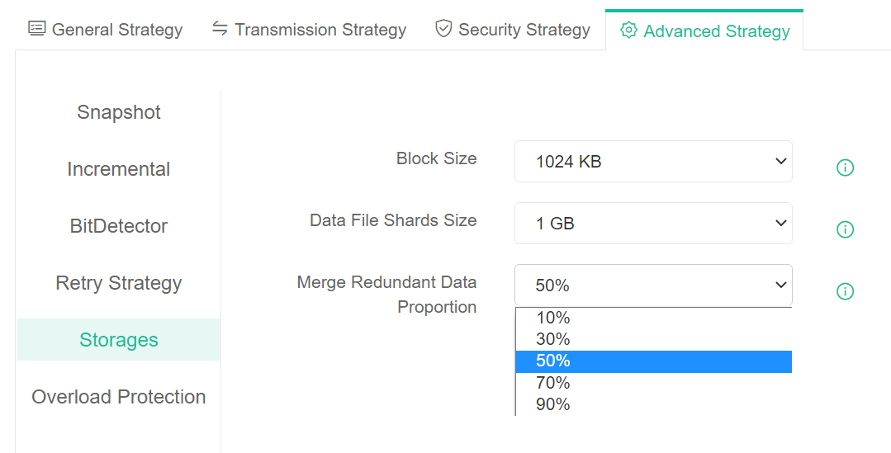
2.1 Backup Chain Merge Optimization
Issue Fixed | 8.1 | 9.0
Data grows after merge; redundant data cannot be reclaimed | Unreclaimable | Reclaimable; saves space
Merge requires updating all dependent point metadata | Slow merge | Optimized logic; faster merge
Merge abort breaks backup chain | Chain unusable | Robust error handling; chain remains usable
PS：Only applies to cloud and full‑machine permanent incremental backups; file‑level permanent incremental is different.
File locks: Read lock (backup/restore/replica) and write lock (merge) are mutually exclusive.
Backup point merge: Only modify bitmap and data files of two merged points; reduces merge time.
Data merge/delete: Asynchronous; page sends message and proceeds; background processing reduces UI wait time.

Slide 10
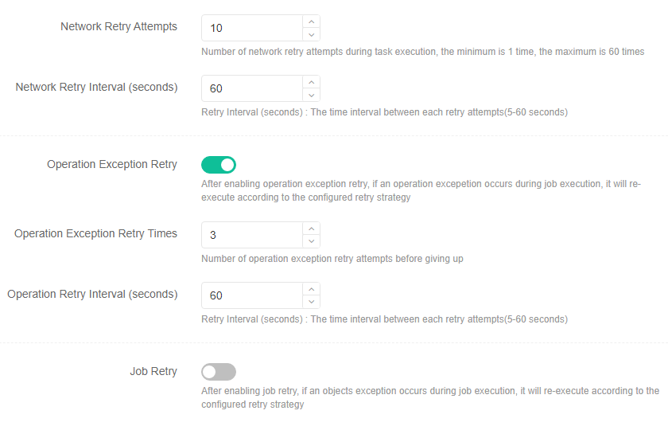
3.1 Retry Policy
Virtualization module: Retry for backup, restore, migration, cross‑platform restore.

Slide 11
3.1 Retry Policy
Virtualization module: Retry for backup, restore, migration, cross‑platform restore.
Network retry: Reconnect on communication timeout; for data transfer and long operations.
Operation retry: Disk open, disk read, disk write.
job retry (off by default):
1.Retry only failed objects.
2.Retry all objects. Succeed within retries → stop retrying; Manual start during retry → stop auto‑retry; Retries exhausted → stop.
3. No job retry for post‑instant‑restore migration.

Slide 12
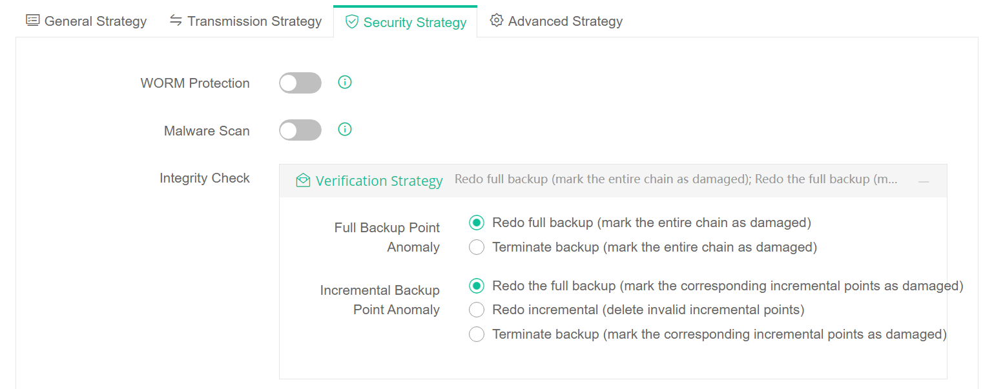
3.2 Security Policy
WORM Protection
Backup points with WORM enabled cannot be modified or deleted before expiration; retention period can only be extended.
Virus Detection
Automatically runs verification job after backup to scan backup data for viruses.

Slide 13
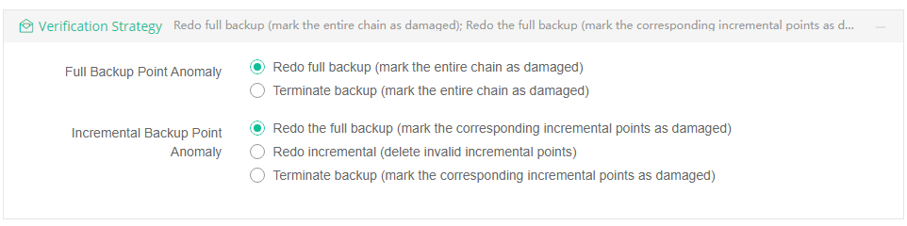
3.2 Security Policy
Integrity Check
Generates unique checksum on backup data creation; rechecks before backup/restore.
Integrity Check allows the system to perform integrity verification on previous points of reference during the verification cycle and generate the information files at the current backup point in time, in preparation for subsequent comparisons.
Differential backups rely solely on the full backup point. Therefore, during each integrity check, the differential backup only verifies the full backup point.

Slide 14
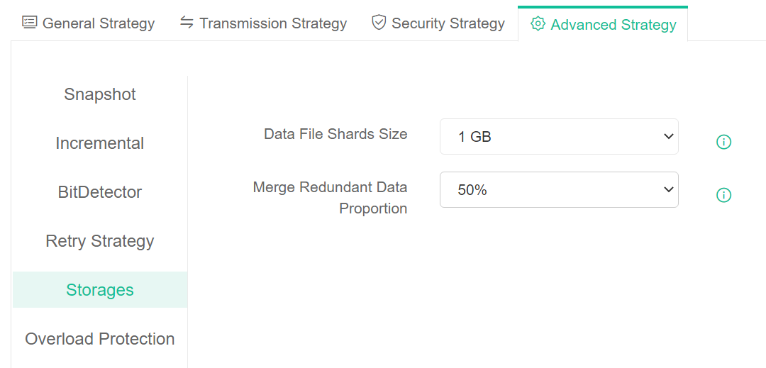
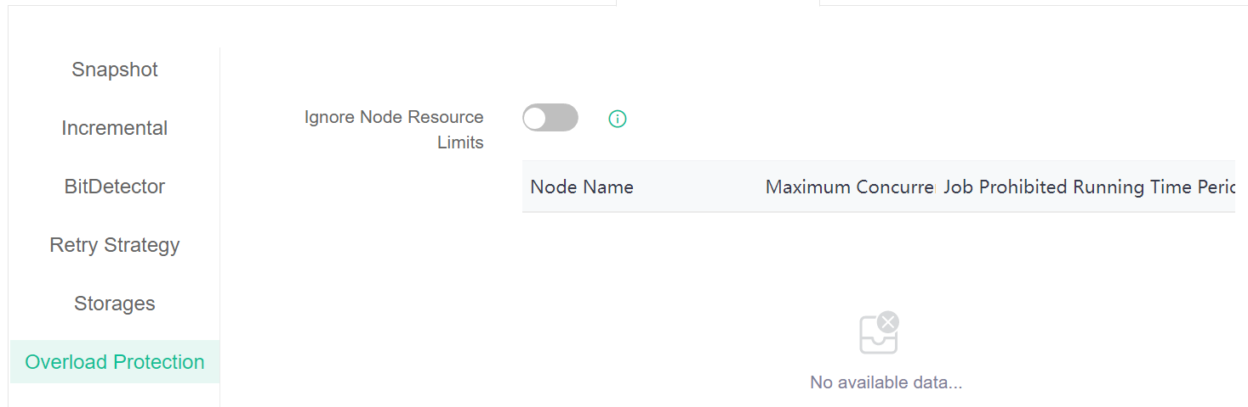
3.3 Advanced Configuration
Redundant data merge ratio：Clean invalid data if exceeds ratio > Merge Redundant Data Proportion.
Data shard file size： The size of data file shards stored at a given point in time; this value is used to manage the creation and reclamation of Storage data files.
Ignore node resource limit ：For jobs with higher priority, you can enable this setting to bypass node resource limits.
Limit the maximum number of concurrent jobs.
Specify time periods during which the job is prohibited from running.

Slide 15
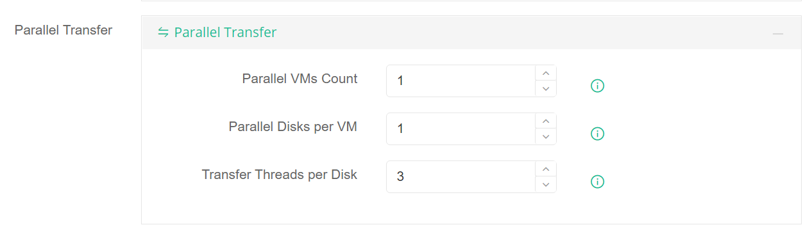
3.4 Huawei FusionCompute KVM transmission strategy
Parallel transmission (backup/restore): A single job transfers n virtual machines and their disks simultaneously based on the specified number of parallel processes, thereby improving transfer efficiency.
Parallel VMs per job
Parallel disks per VM
Threads per disk: 1–8
PS： Currently only Huawei FC supported Parallel transmission; more platforms coming soon.

Slide 16
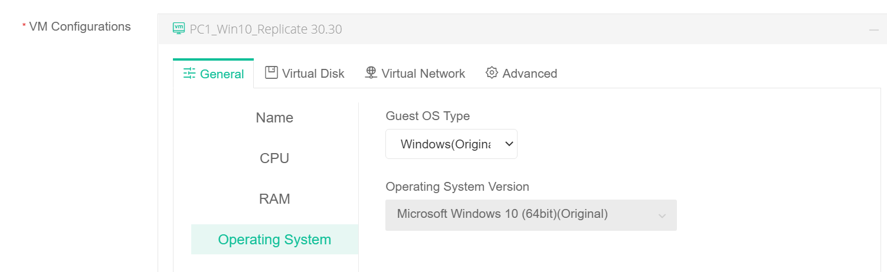
4.1 Restore
VM Configuration—General—OS
Normal restore: Keep original config.
Cross-platform recovery performs a rough match between the operating system type and version saved at a specific point in time and the target platform. If no match is found or an incorrect match is detected, you must manually select or modify the settings (if an incorrect operating system is specified manually, driver replacement may fail).

Slide 17
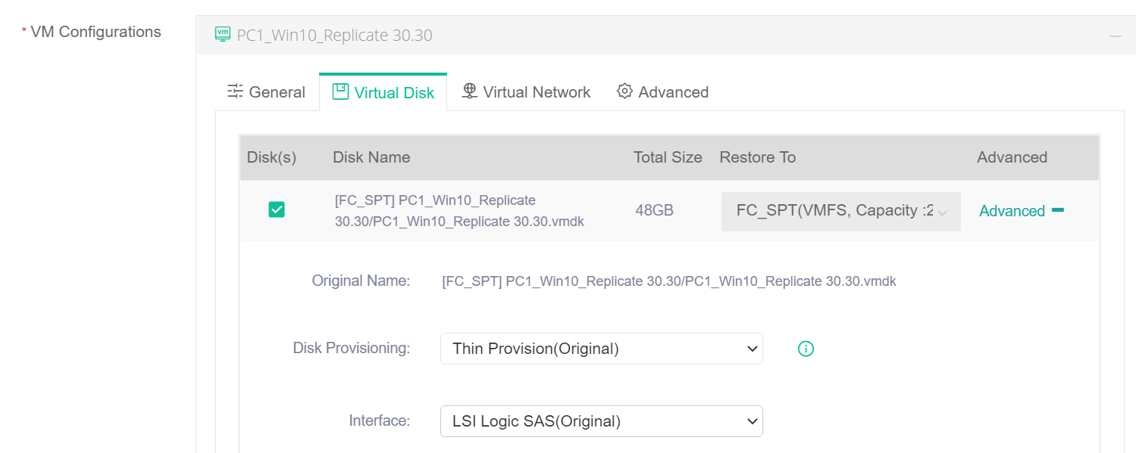
4.1 Restore
VM Configuration—Disk Configuration
Restore to the original platform
Non-Unified Configurations: The target storage/bus type is restored to match the source type by default.
Unified Configurations: The target storage with the largest capacity is selected by default.
Restore to another platform: The target storage is automatically selected as the one with the largest capacity

Slide 18
4.1 Restore
VM Configuration—Disk Configuration
Restore/Cross-Platform Restore Bus Type Selection
For cross-platform disk restores, the bus type defaults to matching the source type.
1. VMware SCSI and KVM SCSI bus types are not equivalent.
2. If the source bus type does not match the target bus type, the disk bus type priority is: virtio -> SCSI > IDE.
3. Restore to VMware priority:
Linux: VMware Paravirtual SCSI
Windows: LSI Logic SAS

Slide 19
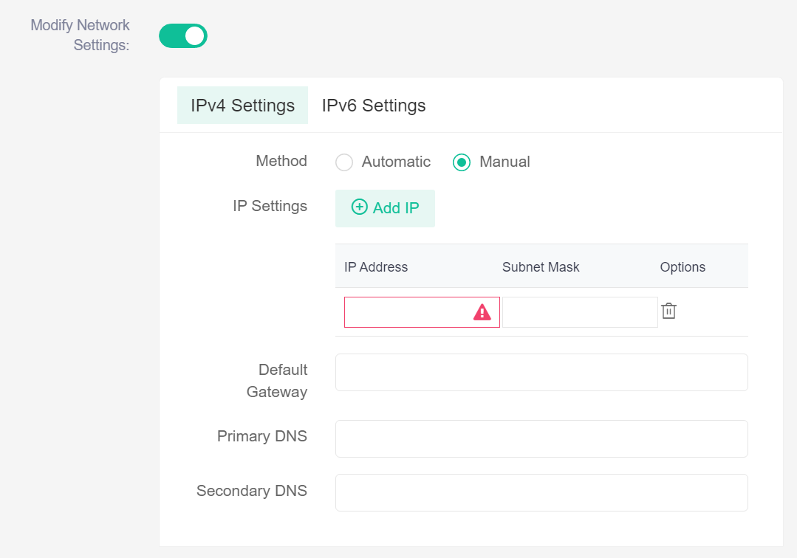
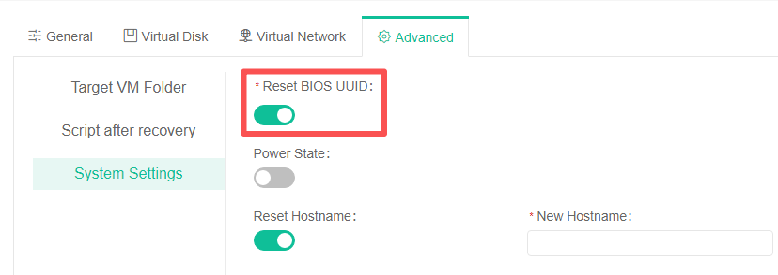
4.1 Restore
VM Configuration—Network Configuration
VM Configuration—Advanced—System Settings
Network configuration is disabled by default.
When enabled, IPv4/IPv6 is configured automatically by default (i.e., DHCP); select “Manual” to configure a static IP address manually.
Power on after the recovery
Reset the hostname (change the hostname/computer name of the virtual machine after restoration)
Reset BIOS UUID (This feature is available only for cross-platform recovery and instant recovery to the VMware platform, and is enabled by default. Disable this option if you need to preserve the original machine's BIOS UUID. This applies to situations where software licensing is tied to the BIOS UUID and the BIOS UUID must be retained when restoring the virtual machine.)

Slide 20
4.2 Granular Recovery
Granular Recovery jobs are commonly encountered in daily use, but issues such as inadequate support for complex disk structures, recovery failures on newer operating systems, slow file download speeds, and limited functionality have prevented them from being compatible with a wider range of complex scenarios.
Building on the original design concept for granular recovery, we have restructured the functionality to address existing issues, enhance compatibility with more scenarios, and expand support for granular recovery jobs across additional modules.
Modules | Functions
Granular Recovery Job Creation | Supported modules | Virtualization, Private Cloud, Public Cloud, Scheduled full-machine backup (new in 9.0), Real-time full-machine backup (new in 9.0)
 | Recoverable data | Full backup points, incremental backup points, differential backup points (supports simultaneous recovery from multiple time points)
 | Recovery method | Create a disaster recovery host, and mount time-point data to the host.
 | Security policies | Backup point virus scanning policy, integrity check policy
Granular Recovery Job running | File download | Check files/folders and download them directly to the local device
 | Client transfer | Check files/folders, create a transfer job, and send them directly to the client (similar to the file recovery function)
 | network share | Check folders, create a shared link based on the SMB protocol. Local PCs can mount the shared folder to the local device via the link address (similar to mounting CIFS storage to the local device for direct access)

Slide 21
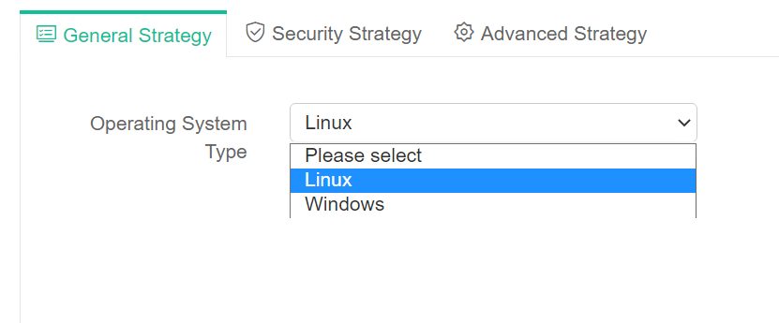
4.2 Granular Recovery
Select Backup Point
Only a single backup point can be selected to create a granular recovery job.
The selected point will be displayed in the Selected backup Points list.
General Policy
Operating system types are categorized as: Windows and Linux.
Select Windows for Windows backup time points，Select Linux for Linux backup points.
The granular recovery module can accurately identify the operating system type and automatically select the corresponding OS (except for virtualization platforms that do not record OS type natively, such as Hyper-V).

Slide 22
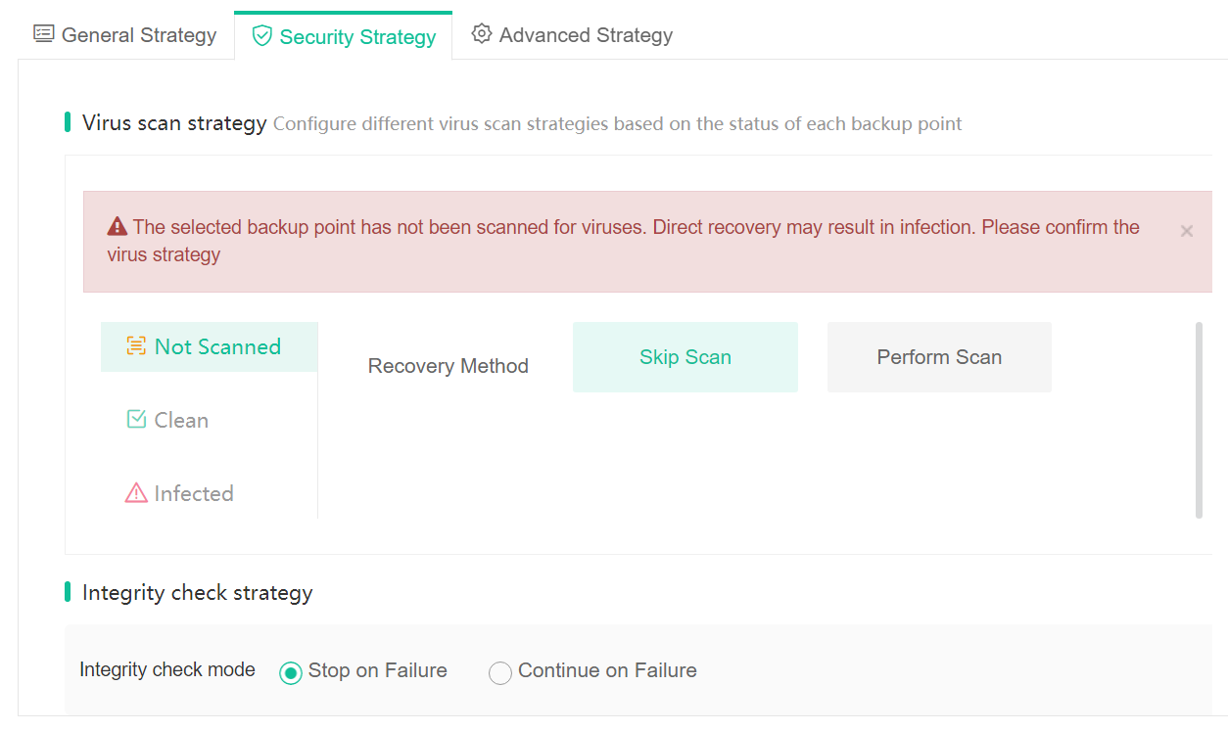

4.2 Granular Recovery
Security Policy
Backup Point Virus Scan Policy: Select different scan policies based on the status of different backup points
Integrity Verification Policy: Configure the integrity verification policy based on the backup job.
Advanced Configuration
Overload Protection - Ignore Node Limits

Slide 23
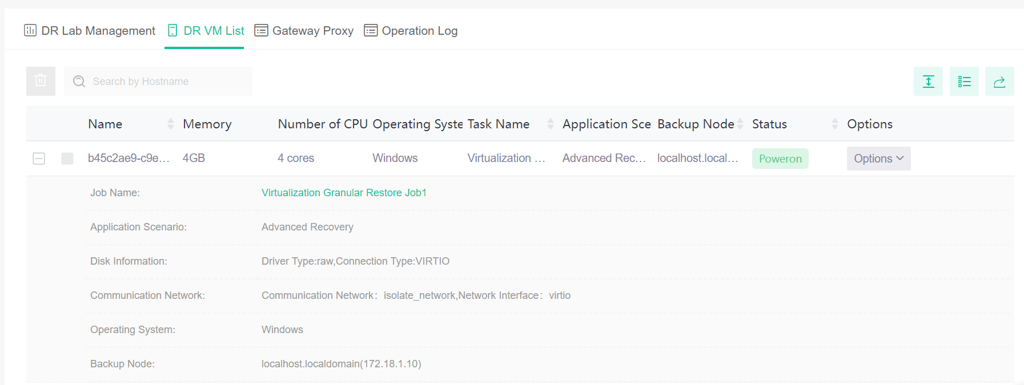
4.2 Granular Recovery –DR VM
1. When a granular recovery job is initiated, a disaster recovery VM is automatically created.
2. Once the granular recovery job is stopped, the disaster recovery VM is automatically deleted.

Slide 24
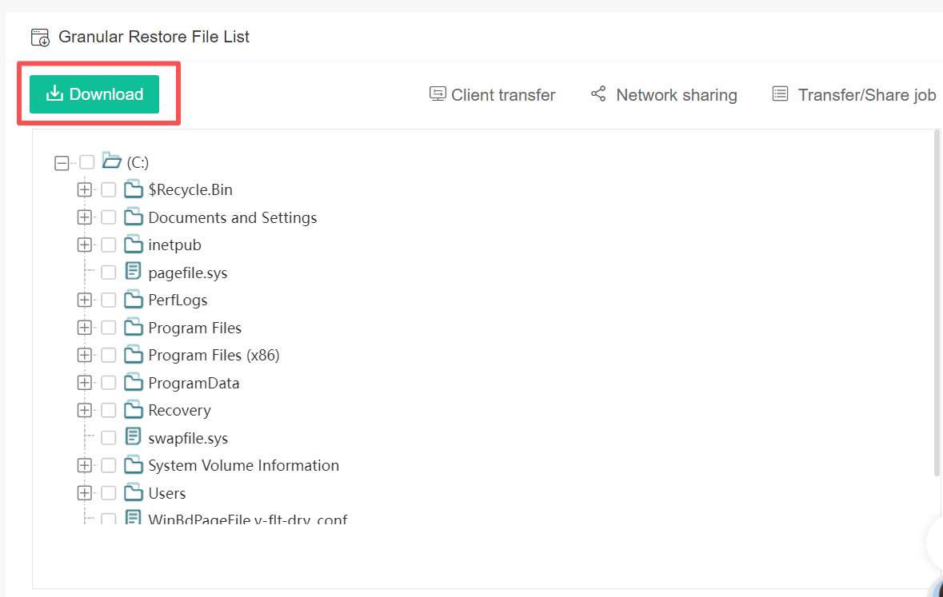
4.2 Granular Recovery-Web Download
Web Download Process
After selecting the files or folders, click the “Download” button
The backup system generates a compressed file.
The browser begins downloading the compressed file

Slide 25
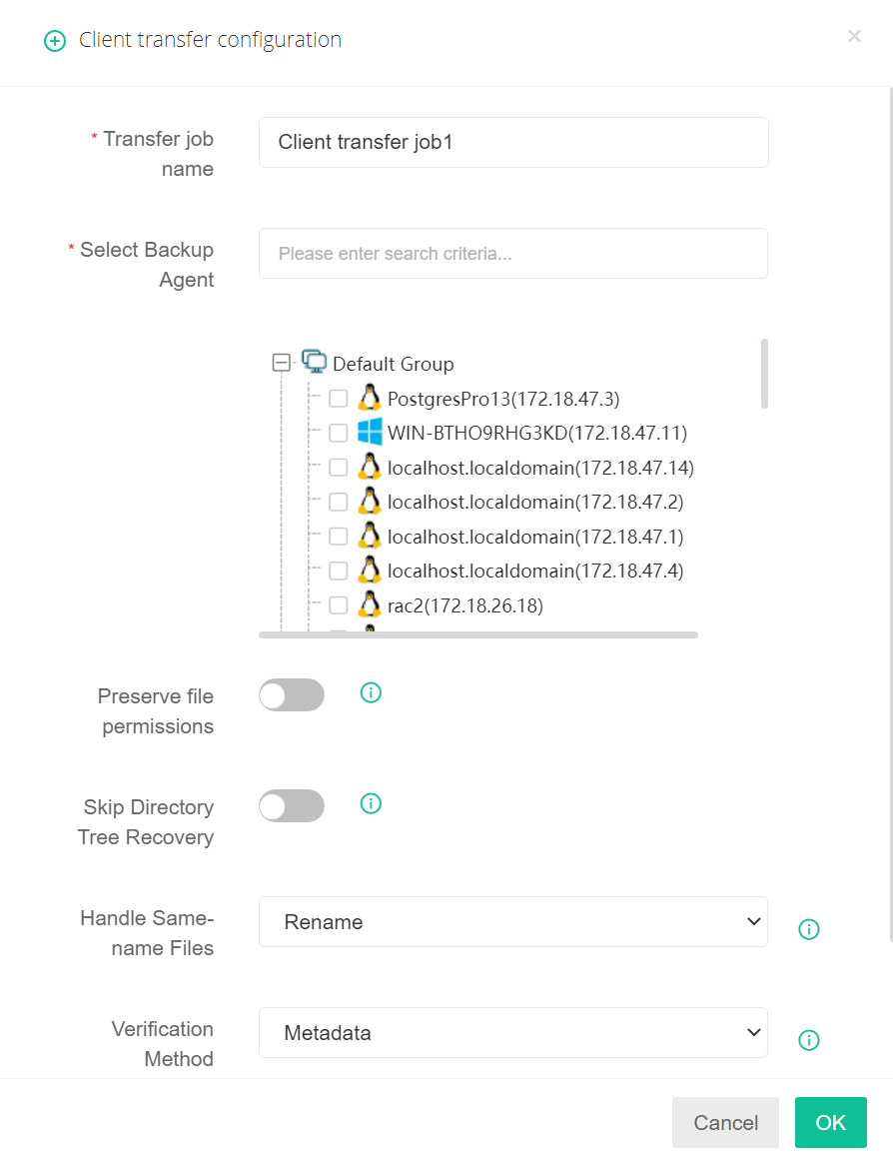
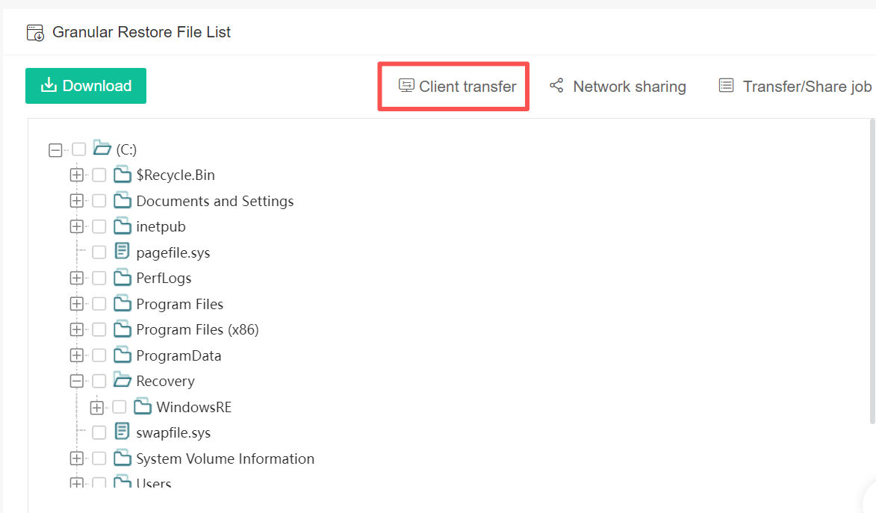
4.2 Granular Recovery-Client Transfer
Client Transfer Process
After selecting the files or folders, click the “Client Transfer” button.
Configure the client transfer policy and submit the job.
Handle Same-name Files：Rename/Skip/Overwrite（ If you select “Overwrite,” you must configure the verification method and overwrite rules. ）
Overwrite rule: Overwrite the target file if it does not match; retain the latest version of the target file if it does not match.

Slide 26
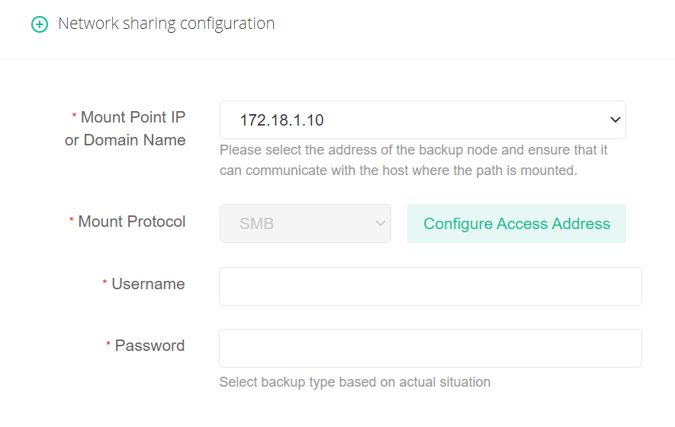
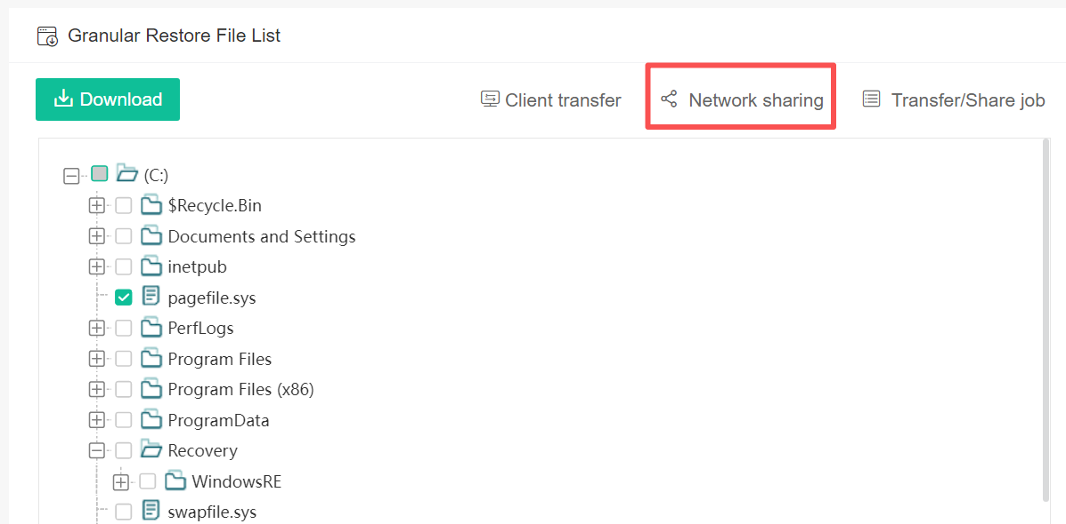
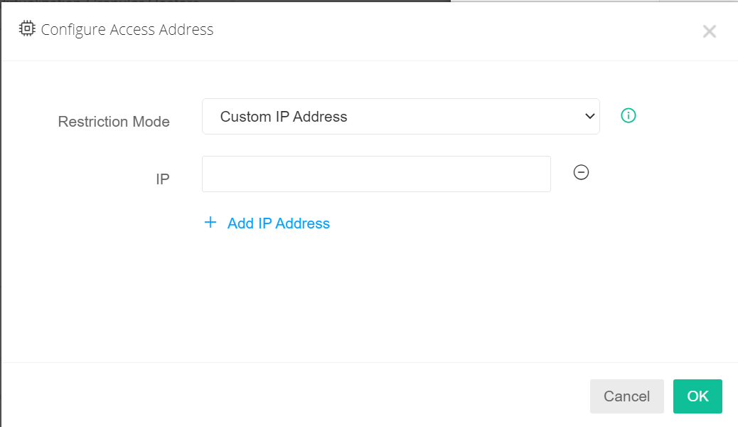
4.2 Granular Recovery-Network sharing
Network sharing（SMB Protocol）Process
After selecting the folder, click the “Network Share” button
Configure the mount settings, then click “OK” to submit
Configure access settings:
No restrictions: The system will not impose any IP restrictions; access is permitted from any IP address.
Custom IP addresses: You can restrict access when sharing resources by entering the allowed IP addresses (multiple IPs are permitted).

Slide 27
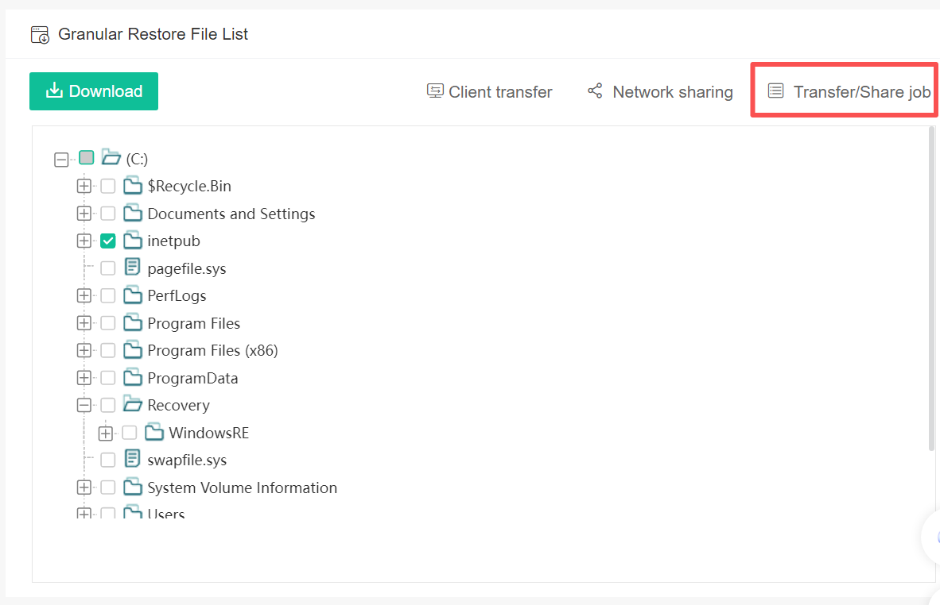
4.2 Granular Recovery- Transfer/Share job
Click“ Transfer/Share job "button

Slide 28

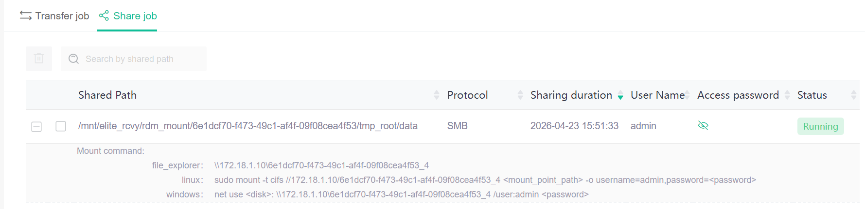
4.2 Granular Recovery- Transfer/Share job
2. Click here to view transmission jobs and shared jobs

Slide 29
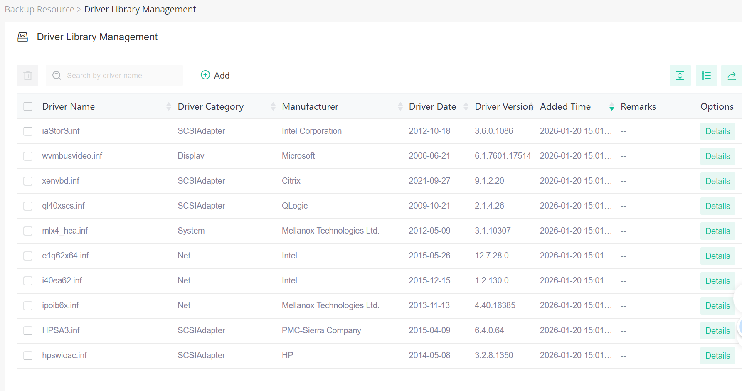
4.3 Driver Library
Instant recovery to heterogeneous platforms/proxy-based environments; X2X cross-platform recovery (V2V, V2C, C2C, C2V, V2P, C2P); supports heterogeneous platform detection and driver detection during job configuration.
Driver Library Management：
Built-in drivers, users can also add the drivers they need on their own.
Drivers are automatically replaced during the system boot process, reducing manual intervention, improving recovery efficiency, and shortening the product PoC duration.
Resolves the issue of having to manually add drivers during system boot.

Slide 30
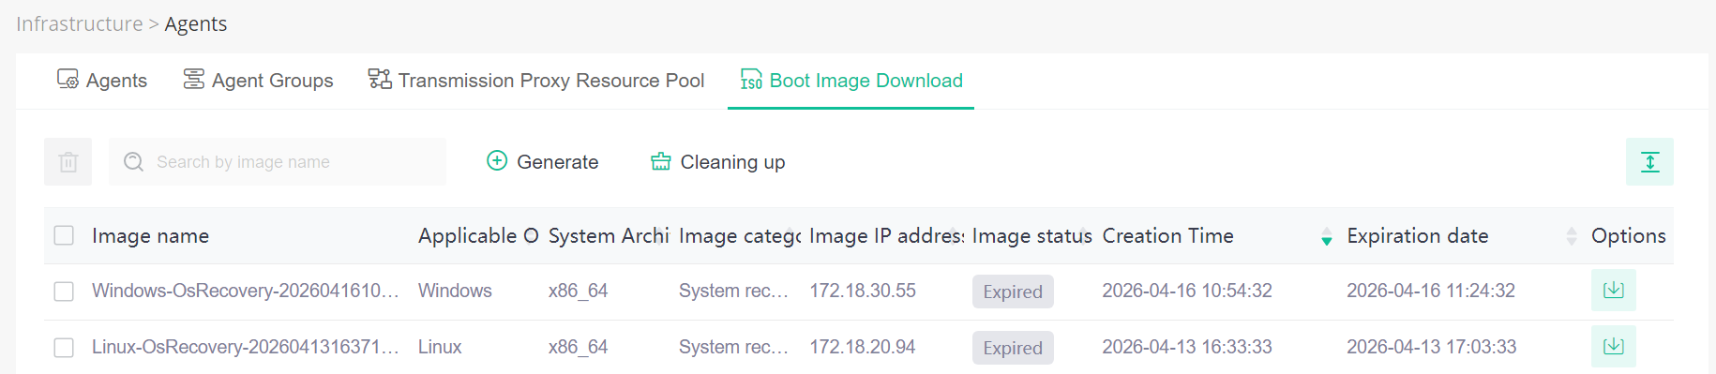
4.3 Boot Image
Unified Multi-Architecture Boot Image Consolidation:
Only one LiveCD image each for x86 and ARM architectures; WinPE supports x86 architecture only.
Automatic Web Interface Image Generation:
The backup system's web interface can automatically generate boot images and provide download links without manual intervention by staff. Generated images can be automatically purged from the backend after a certain period. Upon booting, the generated image automatically connects to the backup system, eliminating the need to run script commands.

Slide 31
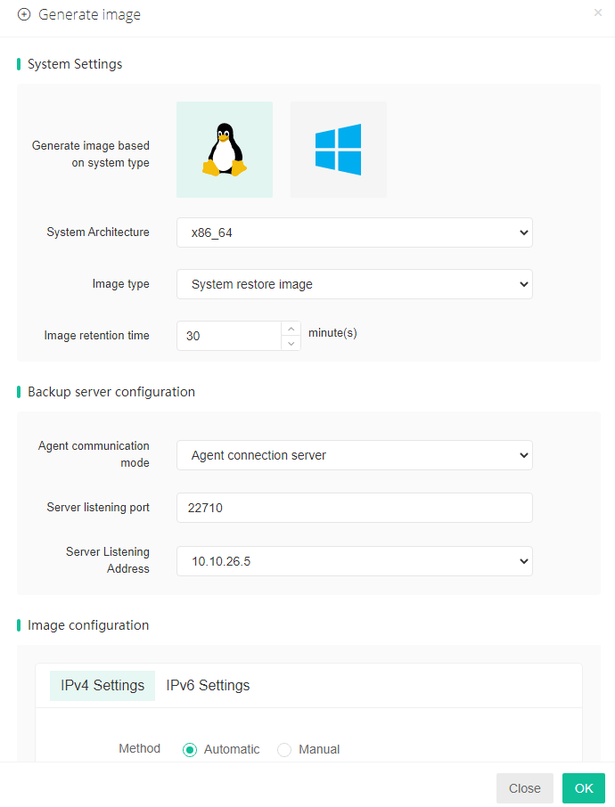
4.3 Boot Image
Graphical User Interface:
All boot images are optimized with a graphical user interface (GUI).
Network Configuration via Web Interface to Reduce Command-Line Operations:
Network settings can be configured directly within the web interface when generating a boot image. Alternatively, network parameters can still be reset using existing command-line methods.
Client-Based Boot Image Transfer:
Install a client on the target recovery machine. The boot image can then be transferred directly via the client to the recovery target. After rebooting the target machine, the recovery job can proceed immediately, minimizing steps such as downloading the image or burning it to physical media.

Slide 32
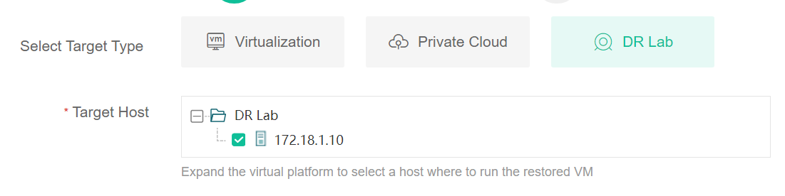
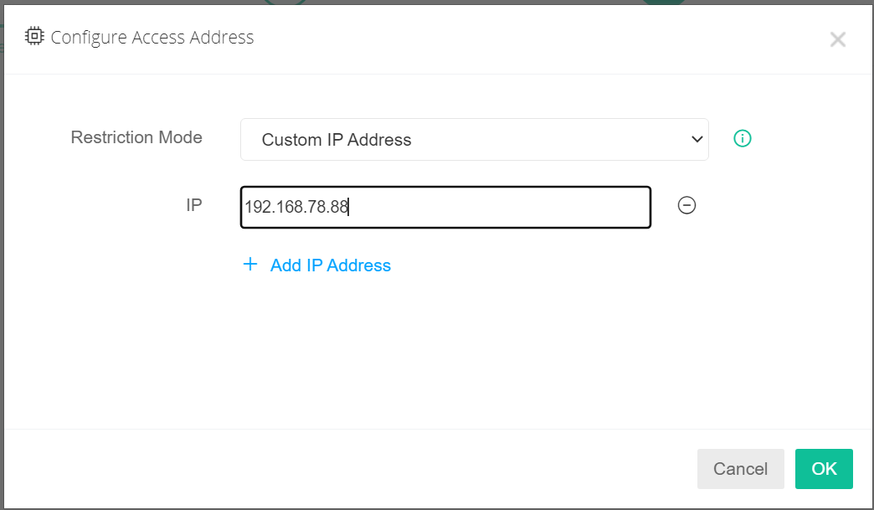
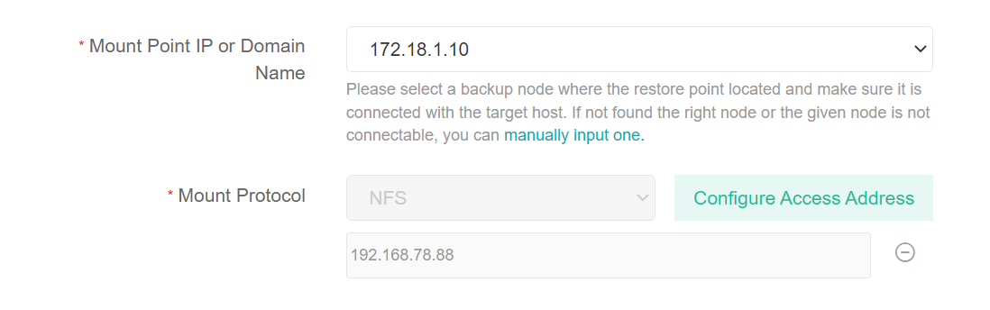
4.4 Instant Recovery
Instant restore to DR Lab
Use Case: Emergency Takeover
Example: A customer has only one production system. If the production system goes down and there is no disaster recovery environment, a virtual machine must be quickly spun up to take over operations. In this case, the system can be instantly restored to the DR Lab.
Instant restore third-party virtualization support for NFS/iSCSI protocols and their access controls
No restrictions: The system will not impose any IP restrictions; access is permitted from any IP address.
Custom IP addresses: If you wish to restrict access when sharing resources, please enter the IP addresses you wish to allow.

Slide 33
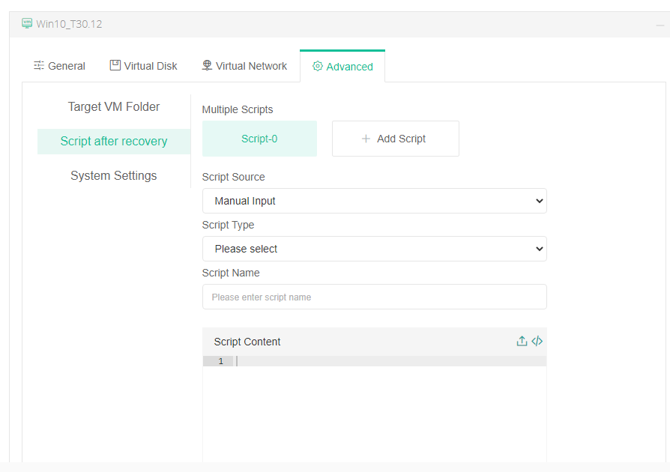
4.4 Instant Recovery-VM Configuration
VM Configuration—Advanced-Script after recovery
The execution of a script depends on the system environment. For example, if Python is not installed, Python scripts cannot be executed; similarly, if a database is not installed, SQL statements cannot be executed.
Linux currently supports only Python and shell scripts.
Windows supports shell, BAT, Python, SQL, and PS1 scripts.
Resolving the issue:
Manually opening certain applications/programs is required for virtual machines that have been instantly restored.
Verifying the health status of key applications, etc.

Slide 34
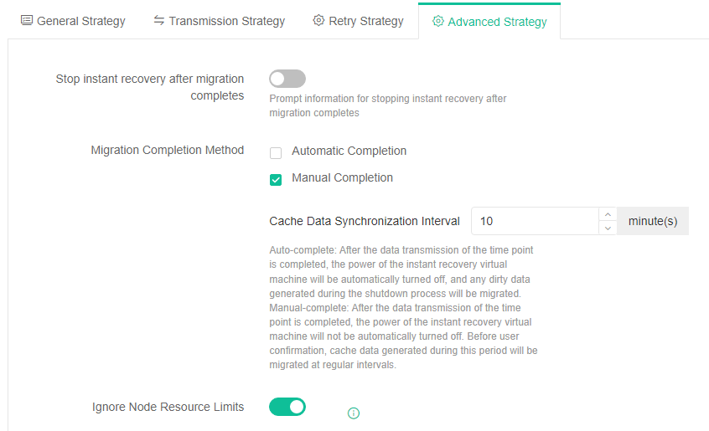
4.4 Instant Recovery-Migration
Instant Recovery-Migration-Advanced
You can choose to stop the instant recovery job automatically or manually after migration is complete.
If you select automatic stop, the instant recovery job will stop and release resources once migration is complete.
If you select manual stop, the job will revert to running as an instant recovery job after migration is complete, until you manually stop it to release resources.
Note: When performing a migration job, if the virtual machine that was temporarily restored is still in use, cache data will continue to be generated. In this case, if you want to ensure that all data is migrated, you can choose to complete the process manually.

Slide 35
4.4 Instant Recovery-Migration
Instant Recovery-Migration-Advanced
Migration can be configured for automatic completion or manual confirmation of completion.
Automatic completion: After point-in-time data transfer is complete, the power to the instant recovery virtual machine will be automatically shut down, and any dirty data generated during the shutdown process will be migrated.
Manual completion: After point-in-time data transfer is complete, the power to the instant recovery machine will not be automatically shut down; instead, cached data generated during the migration will be migrated at regular intervals until the user manually confirms completion.

Slide 36
4.4 Instant Recovery
Instant Recovery - Migration Support Platform
Driver Detection
Backup Source | Instant Recovery Position | Migration support Platform
Virtualization/Cloud | Original Virtualization/Cloud Platform | Original Virtualization/Cloud Platform Server
Virtualization/Cloud | Heterogeneous Virtualization/Cloud Platform | Original Virtualization/Cloud Platform Instant Recovery for Virtualization/Cloud Platforms Server
Virtualization/Cloud | DR Lab | Original Virtualization/Cloud Platform Server
Server | Virtualization/Cloud Platform | Instant Recovery for Virtualization/Cloud Platforms Server
Server | DR Lab | Server
Server | Server | Server
After migrating to a virtualized/cloud platform, you can no longer modify disk or network drive types, exclude disks (though you can exclude networks), reconfigure IP addresses, inject scripts, or change hostnames (i.e., actions that require mounting for processing are prohibited).
When migrating to a platform with an agent, heterogeneous environments must be detected; when migrating to a platform without an agent, this is not required.

Slide 37
4.4 Instant Recovery
Instantly restore to any platform; during migration:
When migrating back to the original platform, ensure that driver-related configurations for the operating system, secondary disks, network cards, and other components match those of the backup point.
When migrating to the instant restore target platform, ensure that driver-related configurations match the instant restore configuration.
Note:
Instant recovery to a host with an agent, and cross-platform recovery to a host with an agent, are only supported for hosts booted via a “boot image.”
Driver detection is performed for both instant recovery to a heterogeneous platform and cross-platform recovery; Driver detection is not required for recovery to the original platform or the original virtualization type.

Slide 38
4.5 Cross Platform Recovery
Modules | Functions
Cross Platform Recovery | Target platform | Virtualization、Private Cloud、Public Cloud、Server
 | Restore Data | Full backup points、Incremental backup points、Differential backup points
 | Function Modules | Consistent with the recovery job configuration information and rules of the target platform
The functional configuration for cross-platform recovery is identical to that of same-platform recovery on the target platform.
Added V2P, C2P, P2V, and P2C cross-platform capabilities.
Virtualization instant recovery has been migrated to agent-based recovery, and cross-platform recovery to agent-based recovery supports only hosts booted via "boot image".
During the cross-platform process, data format conversion, configuration information conversion, automatic driver replacement, and automatic boot repair are all performed automatically.

Slide 39
5.1 Data Verification-Full recoverability verification
Full recoverability verification: Verifies data from the data source and simulates an isolated environment identical to the production network where the source data resides, enabling verification of multi-network architecture configurations, such as network verification and client-server architecture verification.
Function Module | Functions
Verification Method | Verification Type | Automatic verification, Manual verification
 | DR Lab | Automatic creation, Customization
Verification Source Selection | / | Optional application group, Verification object
 | General Configuration | Select time point (latest time point, all unverified time points, specified time point), CPU mode, CPU architecture, CPU socket count, cores per socket, memory size, operating system type, operating system version
 | Verification Configuration | Network verification, heartbeat verification, boot result screenshot verification, virus scanning, integrity check, maximum boot waiting time
 | Network Configuration | Configure IP address, subnet mask, default gateway, MAC address
 | Detection | Heterogeneous platform detection, driver detection
Verification Policy | General Configuration | Startup mode (verify by time schedule, verify immediately)
 | Advanced Configuration | Backup node IP address, number of concurrent verification objects, ignore node resource constraints

Slide 40
5.2 Data Verification-Backup Data Verification & Virus Scanning
Backup Data Verification and Security Scanning: Scans of backup data do not simulate the production environment where the source data resides. This process enables data integrity verification and full-system security scanning.
Function Modules | Functions
Verification Method | Verification Type | Auto-Verification
 | General Configuration | Select time point (latest time point, all unverified time points, specified time point), operating system type
 | Verification Configuration | virus scanning, integrity check
Verification Policy | General Configuration | Triggering method (verification based on a time schedule, immediate verification)
 | Advanced Configuration | Backup node IP address, number of concurrent verification objects, ignore node resource constraints

Slide 41


THANKS
云祺公众号
云祺视频号

