Slide 1
Vinchin Backup&Recovery
V9.0.0
System and Public Functions

Slide 2
CONTENTs
PART 01
System
PART 02
Backup Cluster
PART 03
Backup&Restore General Features
PART 04
Ransomware Protection and Integrity Verification
PART 05
WORM & Virus Scan
PART 06
DR Lab

Slide 3
PART 01
System

Slide 4
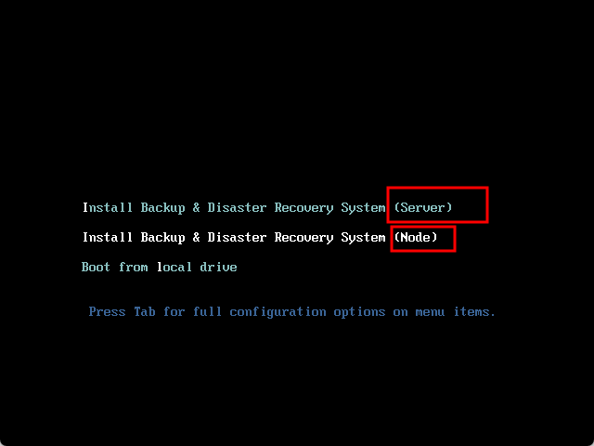
System
What changes have we made?
1、Single ISO – Server and Node now share one image. Select type at boot.
2、Local Node DB – Supports cluster failover with sub-to-master promotion.
3、Add nodes directly from Server UI; no manual commands required.

Slide 5
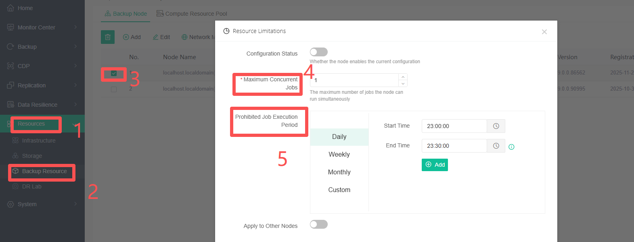
Backup Resource-Resource Limitation
Maximum Concurrent Jobs
Prohibited Job Execution Period

Slide 6
Resource Limitation
Notice
• Backup jobs are restricted by default when limit is active.
• Override option: "Ignore Node Resource Limit" available in job settings.
• Restore jobs are not restricted by default.
Why do we do it？
Prevents node overload and crashes.
Enables concurrency control for large-scale backup environments.

Slide 7
Backup Resource-Script Management
Extends standard features with custom scripts for greater DR flexibility.
Examples:
Pre‑processing scripts before backup
Automated data verification
Application/service handling during takeover
Support Modules:
Database Protection, Database Scheduled Recovery (Verification/Drill), Server Protection,
Server Real‑Time Protection,
Server Replication,
Server Takeover,
Instant Recovery to Embedded
Cross‑Platform Recovery
How to use it？
Pre‑save scripts under [Resources] – [Backup Resource] – [Script Management] , or edit and save scripts directly during job creation.
Select the desired script when creating a job.
Supported script types: Shell (.sh), Batch (.bat), Python (.py), SQL (.sql), PowerShell (.ps1)

Slide 8
PART 02
Backup Cluster

Slide 9
What is Backup Cluster?
Server + multiple Nodes = HA cluster with failover.
A cluster of one Server and multiple Nodes provides Server failover for high availability, eliminating single points of failure.
Key Features:
Cluster Node Monitoring – Real‑time status tracking of all nodes.
Server Failover via Heartbeat – Automatically promotes a sub node to master upon Server failure, ensuring uninterrupted service.
VIP Access
Automatic Load Balancing – Eliminates manual job distribution across nodes; workload is balanced automatically.
HA
Resource load balancing
Data Resilience

Slide 10
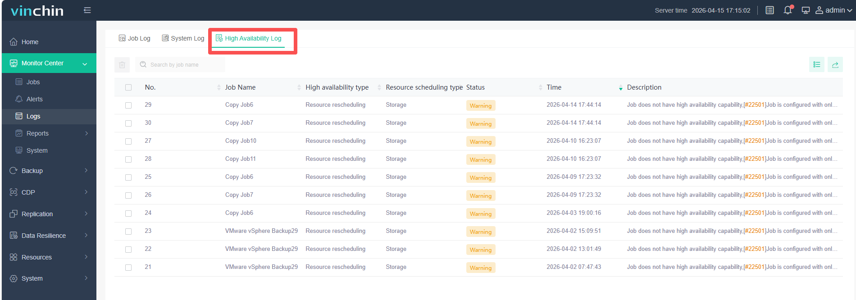
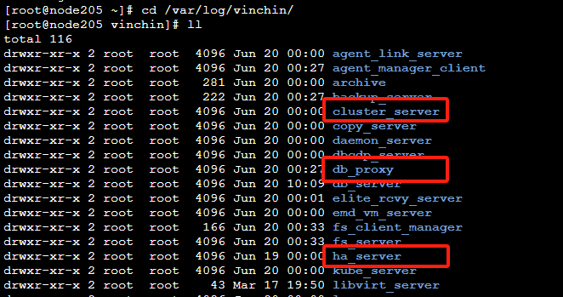
Backup Cluster –Log and Server
cluster_server – Cluster Management Service
Manages cluster configuration, startup, failover, shutdown, and dynamic node management.
Handles Agent client IP updates for backup system connectivity.
Monitors resource status and allocates resources for jobs.
ha_server – High Availability Service
Ensures backup cluster HA.
Performs failover when the master node fails.
db_proxy – Database Proxy Service
Routes all service process database access through the proxy (direct access when clustering is disabled).
Synchronizes databases across all cluster nodes (active and standby).
【Monitor Center】-【Logs】-【High Availability Logs】
Backend log :cd /var/log/vinchin/

Slide 11
Backup Cluster -Node
Backup Node:
Cluster Composition
A cluster node can be either a Server or a Node.
Node Capabilities
Each node may have Management and/or Compute functions.
  Server nodes always include Management (non-removable); Compute can be added or removed.
  Node nodes support flexible enablement of both functions.
Role Assignment
  Only nodes with Management capability can join as cluster members.
  The cluster maintains one active Management node (provides Web UI and management services); others remain on standby.
  Nodes with Compute capability execute backup and restore jobs.
Connectivity
  Clients and virtualization platforms connect via the cluster VIP.
  Inter‑node communication uses each node's own IP.

Slide 12
Backup Clusters- Configuration and Usage
Prerequisites:
Under [Resources] – [Backup Resource] – [Backup Node] , add two or more nodes with Management capability.
Cluster Configuration Entry:
[Resources] – [Backup Resource] – [Cluster Management]
Cluster Configuration Steps:
Set the Cluster Name.
Set the Cluster VIP Address (the VIP will be assigned to the prod_bridge interface of the master node).
Set the Heartbeat Interval (if the master node fails to recover within this period, automatic failover will be triggered).
Select at least two Management capable nodes to form the backup cluster.

Slide 13
Cluster Management Operations:
Start Cluster:
After configuration, the cluster is not started by default. Click [Start Cluster]. On first startup, the Server node becomes the primary node by default.
Manual Failover:
Once the cluster is running, you may manually switch the primary role. Select a node and click [Switch to Primary].
Stop Cluster:
While the cluster is running, click [Stop Cluster] to halt cluster services.
Modify Configuration:
Configuration changes are allowed only when the cluster is stopped or not yet started. Click [Edit Configuration] to edit settings.
Operation Logs:
Manual actions and automatic failover events are displayed in the log area below (recent entries only). For full logs, go to [Monitor Center] – [Logs] – [HA Log].
VIP Redirection:
Accessing any node via its individual IP will automatically redirect to the VIP.

Slide 14
Backup Clusters—How Clusters Work/Failover Process
Cluster Failover Process
Equal weight for all nodes.
Only one active (master) node exists for HA purposes; job execution has no primary/standby distinction.
Clients connect via VIP.
The primary node syncs data to standbys in real time, with a full sync every 30 minutes.
Heartbeat monitoring triggers failover.
VIP migrates to a randomly chosen standby, which becomes the new primary. Failover takes ~2–3 minutes; the original primary remains standby upon recovery.
Resource pools checked every 10 seconds.
Offline resources retry every 5 seconds; after 120 seconds, jobs are reassigned.
Standby nodes auto-reconnect.
Upon reconnection, database sync runs before the node returns to online status. Cluster startup also waits for initial sync.

Slide 15
Backup Clusters—Resource Pool Configuration and Usage
How to Enter?
Compute Resource Pool:
[Resources] > [Backup Resource] > [Backup Nodes] > [Compute Resource Pool]
Storage Resource Pool:
[Resources] > [Backup Resource] > [Backup Nodes] > [Compute Resource Pool]
Proxy Resource Pool:
[Resources] > [Infrastructure] > [Agent & Proxy] > [Transmission Proxy Resource Pool]
Network Resource Pool:
[Resources] - [Backup Resource] - [Backup Node] - [Select Node] - [Network Map] - [Network Resource Pool]

Slide 16
Backup Clusters—Resource Pool Introduction
Cluster vs. Resource Pools
Cluster: Provides high availability (HA) for the backup system itself.
Resource Pools: Provide HA and load balancing for various resources. A single‑node backup system can already leverage Resource pools for HA and load balancing—no cluster required.
Resource pools can also function within a cluster for combined HA at all levels, or be used independently. Pools have no binding relationships with each other.

Slide 17
Four Resource Pool Types:
Compute Resource Pool
Consists of nodes with Compute capability.
Consists of storage attached to nodes. Three subtypes; each pool accepts only one storage type:
Centralized Storage Pool: Local disk, partition, directory, LVM volume, FC, iSCSI.
NAS Storage Pool: CIFS, NFS, Huawei OceanProtect (NFS/CIFS).
Cloud Storage Pool: All supported cloud storage.
Tip: NAS storage is auto‑mounted to all compute nodes by default (can be disabled during addition). Remote backup systems and tape storage cannot be added to storage pools.
Storage Resource Pool
Consists of service‑module proxies/agents connected to nodes. Excludes host clients.
Proxy Resource Pool
Consists of networks attached to a single node (i.e., server‑side networks). Not aggregated across nodes, and not related to backup source networks.
Network Resource Pool

Slide 18
Backup Clusters—Overview of Resource Pool Capabilities
Compute Resource Pool
Storage Resource Pool
Proxy Resource Pool
Network Resource Pool
Supported Modules
ALL
ALL
Virtualization, Private Cloud, S3, HDFS
File, K8S, Database, Server(Connection Mode 2 only)
Job Creation
Randomly select an initial compute node from the pool
Randomly select an initial storage node from the pool
Randomly select an initial proxy from the pool
Randomly select an initial network resource from the pool
Re-select node based on load
Retain initial storage
Re-select proxy based on load
Retain initial network
• Centralized storage: Job fails if node offline
• Non-centralized storage: Auto-switch to online node if offline
• Auto-switch to other storage if initial offline
• Job fails if storage full (future release)
• Auto-switch to other network if initial offline
Job Startup
• Auto-switch to other proxy if offline
Periodic node health check
• Auto-switch to online node for next run if offline
Periodic storage health check
• Auto-switch to online storage + degrade to standby if offline
Periodic proxy health check
• Auto-switch to online proxy for next run if offline
No health check
Idle State
• Distribute jobs evenly across nodes
• Auto-switch to idle nodes if current node is overloaded (high CPU/memory)
• Distribute jobs evenly across proxies
• Auto-switch to idle proxies if current proxy is overloaded (high CPU/memory)
Load Balancing
Not supported
(Storage switch triggers degradation)
Not supported
Auto-switch to online node if last running node is offline
Auto-switch to online storage + degrade to standby if last running storage is offline
Auto-switch to online proxy if last running proxy is offline
Auto-switch to online network if last running network is offline
HA

Slide 19
Backup Clusters—Resource Pool Operation Logic
How to Ensure High Availability When Resources Go Offline, and When to Reallocate Resources to Jobs？
Checks resources every 10s, retries every 5s. After 120s of unresponsiveness, marks as Offline and reassigns pending jobs.
When does load balancing occur?
Before each job execution.
How are resources selected? What rules are used to select and allocate resources? (Compute resource pools and proxy resource pools)
Offline resources are excluded.
For each available resource, the system checks whether any single load metric exceeds its threshold. If so, that resource is excluded.
From the remaining resources, the one with the lowest overall load is selected.
If all resources exceed a load threshold, the system still selects the one with the lowest overall load among them.

Slide 20
Backup Clusters—Scenario Support and Important Notes
Supported Failure Scenarios (Server Breakdown):
Master node crash
Master node network outage
Master node shutdown
Master node power loss
What scenarios do we not support?
Centralized storage failure (e.g., local disk failure on the master node)
Backend service process failure (not currently supported)

Slide 21
Notes:
While cluster is running, only node addition allowed. Other config changes require stopping cluster first.
Snapshot taken on master node after enabling cluster may freeze I/O, causing heartbeat failure. Keep heartbeat interval ≥30s.
Failover takes time. Avoid frequent master node power cycling. Stop cluster or configure hardware/software before starting.
All nodes offline simultaneously (e.g., power outage) unsupported. Power on original master node first during recovery.
X86, ARM, C86 nodes can be added to same Server, but cannot form a cluster.
Failure of any critical service (cluster_server, ha_server, db_proxy) disables HA.
For upgrades: stop cluster → upgrade all nodes → restart cluster.

Slide 22
PART 03
Backup&Restore General Features

Slide 23
Advanced Strategy——Retry Strategy
A multi-level retry strategy to improve job success rates across various exception scenarios.
Network Retry
Operation Retry
Job Retry
Reconnects and resumes jobs from the interruption point after a network outage.
Reduces job failures caused by network issues.
Configurable retry count and retry interval.
Job fails if network remains unreachable after all retries.
Retries failed remote operations (e.g., API calls, RPC failures).
Reduces job failures due to transient RPC errors.
Configurable retry count and retry interval.
Job fails if the operation still cannot be completed after all retries.
Automatically re-runs a failed job.
Reduces job failures caused by miscellaneous exceptions.
Configurable retry count and retry interval.
Option to retry failed objects only – avoids re-backing up already successful objects, improving efficiency.

Slide 24
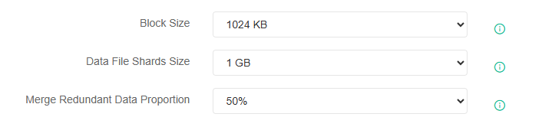
Advanced Strategy——Storages
Purpose: Optimizes data handling efficiency for file creation and merge. (Applies only to Server and VM modules.)
Data File Shards Size:
Backup point storage is organized by this value (it is a logical organizational unit and does not directly correlate to actual disk space usage).
Data file creation and reclamation both operate at this chunk size. Data file fragments are smaller, resulting in more efficient data processing during backups and faster comparison of changes during merge and recovery.

Slide 25
Merge Redundant Data Proportion:
During data merge, invalid data is identified and evaluated for cleanup. A quantifiable threshold is required to determine when cleanup should occur.
Trigger rule: Cleanup is triggered when the amount of redundant (invalid) data exceeds:
Single Chunk Size × Merge Redundancy Ratio
To trigger cleanup more frequently, lower this ratio.
To defer cleanup and retain more historical data, increase the ratio.
Tip:
If the chunk size is modified after a job has already run, the next job will downgrade in performance or efficiency.

Slide 26
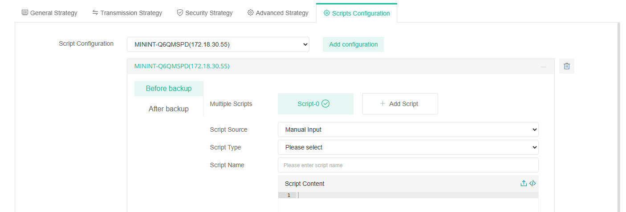
Script
Use scripts when creating jobs; different business modules support the use of scripts at different stages.

Slide 27
PART 04
Ransomware Protection and Integrity Verification

Slide 28
Storage Protection
To prevent malicious destruction or tampering with backup data and the backup system in the background, security measures have been enhanced beyond the existing ones.
Before V9.0.0
Before V9.0.0
Takes effect after a few minutes.
VDP (Ransomware Protection Program)
Protects backup system processes and backup data from tampering or deletion by external programs.
Features:
Auto‑loads at boot – Protection takes effect immediately once [Ransomware Protection] is enabled in the UI.
Cannot be manually disabled in the background – Ensures continuous protection of secured data.
Anti‑uninstall protection – Prevents VDP from being uninstalled, eliminating a potential bypass of protection.
Protected Scope:
/opt/vinchin – Backup system program files
/backup_storage – Backup data
/etc/vinchin – Configuration files
/etc/backup_system – OEM configuration files
Notes:
1. If the backup system is in UEFI mode and Secure Boot is enabled, the VDP driver must be loaded manually after installing the backup system. Please note that the backup system will restart during this process.

Slide 29
Integrity Check
Limitations:
Scheduled backup only; real‑time protection unsupported (data constantly changing).
Hardware/storage failures undetectable; checks only for data changing.
Principle：
When [Integrity Check] is enabled for a job, a metadata checksum key (including filename, size, attributes, creation time, etc.) is generated and stored encrypted on the backup storage after each backup completes.
During an integrity check, the system recalculates the current metadata checksum key of the restore point and compares it with the originally stored key to determine if any changes have occurred since the restore point was created.

Slide 30
Verification after Backup: Verifies the timestamps generated during the current backup (i.e., the current backup chain; newly generated backup points are not verified)
Configurable verification Period: Once a week / Once a day / After every backup
Handling of integrity verification exceptions:
Full backup point exception: Re-do full backup (mark the entire chain as corrupted) / Abort backup (mark the entire chain as corrupted)
Incremental backup point exception: Re-do full backup (mark the corresponding incremental point as corrupted) / Re-do incremental backup (delete invalid incremental points) / Abort backup (mark the corresponding incremental point as corrupted)
Verification during recovery: Verify the selected point in time and its dependent points.
Handling integrity verification exceptions: Abort recovery / Continue recovery / Resume recovery in an offline environment
Function: Monitors backup data for unexpected changes, automatically applies backup corrections based on configured settings, and alerts users to facilitate early intervention.

Slide 31
PART 05
WORM & Virus Scan

Slide 32
WORM Introduction
What is WORM?
WORM is a storage feature that allows data to be written once and read many times. It is mainly used for long-term retention of critical data and prevents unauthorized alteration.
Key Features：
Immutability: Data is read-only after writing and cannot be modified or encrypted.
Non-deletability: Data cannot be deleted before its protection expires.
Background:
WORM addresses flaws in traditional Storage Protection, which could not prevent malicious deletion by admins (via leaked credentials or console operations) or overwriting by repeated invalid backups.

Slide 33
WORM Introduction
Function & Effect
WORM is provided by VDP (Ransomware Protection Program), loaded automatically with the system kernel.
Once a WORM retention period is set, backups cannot be deleted by any means before expiration, including:
Root user deletion from backend
Admin deletion via web console
Retention policy execution
Working Principle
When WORM is enabled, VDP marks backups and records an expiration time using an independent internal clock (not affected by external/system time changes). VDP monitors system time and adjusts the WORM period accordingly.
During protection, VDP blocks all deletion or modification. When expired, the WORM mark is removed, allowing normal retention, merging, and manual deletion.

Slide 34
WORM Introduction
Difference: Ransomware Protection vs. WORM
Both are powered by VDP.
Ransomware Protection: Prevents backend tampering/deletion but allows admin manual deletion and retention policy cleanup.
WORM: Enhanced protection that blocks all deletions (including admin operations, policies, and merging) until expiration.
Third-Party & Native WORM
Cloud Storage: Supports integration with cloud object locking (WORM) for object-level immutability.
Native WORM: Implemented via VDP for local storage and devices without built-in WORM.

Slide 35
Usage and Important Considerations of WORM
All scheduled protection modules, replication, and archival jobs support WORM.
Configuration Entry & Steps:
In [Resources] – [Storage Management] – [Backup Storage] , click [Add] when adding storage, or select an existing storage and click [Modify] . Enable [WORM Configuration] .
When creating a job, enable [WORM Protection] under [Security Policy] . Set the desired WORM retention period.
In [Backup Data] , view backup data details to set or adjust the WORM retention period for specific restore points.

Slide 36
Notes:
Prerequisite: WORM must be enabled on the storage itself.
WORM retention period is calculated from the time backup completes. If an incremental restore point is created, the WORM retention period of the associated full backup will be updated to match the latest incremental point's WORM period.
Once WORM is enabled on storage, it cannot be disabled and the storage cannot be deleted if any backup data within it is still under WORM protection.
Data under WORM protection is exempt from retention policy enforcement and will not be merged.
The WORM retention period for backup data can only be extended, not shortened or canceled.
Perpetual Incremental and WORM are mutually exclusive because perpetual incremental requires merging restore points, which conflicts with WORM immutability.
For shared storage (e.g., NAS) and SAN storage, WORM protection only prevents local tampering or deletion within the backup system. It cannot prevent destructive actions performed directly on the storage side (e.g., manual deletion, modification, unmounting).
For customers with strict ransomware protection requirements, it is recommended to deploy a backup appliance using local storage as the backup target.

Slide 37
Virus Scanning Introduction
Rationale:
Backup data may already contain viruses. Restoring from infected backups could lead to secondary infection. To address this, we provide the ability to scan backup data in a embedded isolated environment and remove virus files during restore.
Supported Modules:
All modules that perform server backups (including virtualization, public cloud, and private cloud). Other modules are not supported.
Supported Antivirus Engines:
Open source: ClamAV
Commercial: Kaspersky

Slide 38
Mechanism & Effect:
Backup data is mounted to a temporary host spun up within the embedded isolated environment (the DR Lab launches a dedicated host to run the antivirus engine).
The antivirus engine scans all data and flags detected virus files.
During restore, virus files can be cleaned before recovery, ensuring a secure restoration.
Note: This feature depends on the Disaster Recovery Drill platform. Please ensure CPU VT support is enabled.
Features & Benefits:
Isolated scanning environment – Viruses cannot execute within the backup system or spread to production networks.
Embedded antivirus engines – Ready to use; no additional antivirus infrastructure required from the user.
No data exposure – Backup data is never mounted externally, eliminating data leak risks.
Tamper‑proof – Data is mounted read‑only to the scanning host; backup integrity remains intact.
Fully automated – Scanning and flagging occur without manual intervention.

Slide 39
Using the Virus Scan
Backup Jobs
Restore / Takeover Jobs
Verification
In the backup job [Security Strategy] , enable [Virus Scan] .
Configure Scan Policy:
Default: Scan the latest restore point only.
Optionally enable [Scan all unscanned restore points] . When enabled, set the maximum number of restore points to scan concurrently.
Set Scan Threads – Number of parallel scanning threads.
Set Scan Scope:
Full disk scan available.
Specify scan paths – Scan only selected directories/files.
Exclude scan paths – Skip specified directories/files. Exclusions take priority over inclusions.
In the restore job [Security Strategy] , choose how to handle restore points of different statuses: Not scanned / Clean / Infected.
Choose action: Restore directly or Perform scan.
When scanning is selected, configure handling policy:
  Action on scan failure/virus detection: Abort restore / Restore after disinfection / Restore to isolated network.
Set Scan Threads – Number of parallel scanning threads.
Set Scan Scope – Same configuration options as backup jobs.
In the verification job [Verification Configuration] , enable [Virus Scan] .
All other configuration options are identical to backup jobs.

Slide 40
Restore points where viruses are detected will be marked. Details can be viewed in [Backup Data Mgmt] – [Restore Point Details] . The number of detected virus files is also recorded in the job log.
Virus definitions can be updated in [Resource Mgmt] – [Infrastructure] – [Virus DB Mgmt] .
The compute resources allocated to the built‑in scanning host can be configured in [Resource Mgmt] – [Disaster Recovery Drill Platform] .

Slide 41
PART 06
DR Lab

Slide 42
DR Introduction
Granular Restore
Cross-Platform Restore
Instant Restore
Takeover
Verification
Virus Scan
Notes:
主要讲解验证

Slide 43
THANKS

